Slide 1
Recognizing Innovative Technologies
Darren Fast, Ph.D.
President, Solalta Advisors Ltd.
Feb 17th, 2010

Slide 2
“Ideas won’t keep. Something has to be done about them. When and idea is new, its custodians have fervor, live for it and if need be, die for it.”
  Alfred North Whitehead

Slide 3
Outline
About me
Innovation value chain
Types of innovation
Sources of innovation
Picking the right type of innovation
Identifying Innovators
Screening innovative ideas
Summary

Slide 4
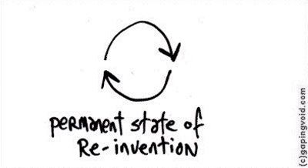
About me

Slide 5
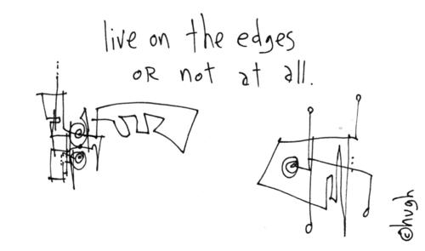

Slide 6
Innovation value chain

Slide 7
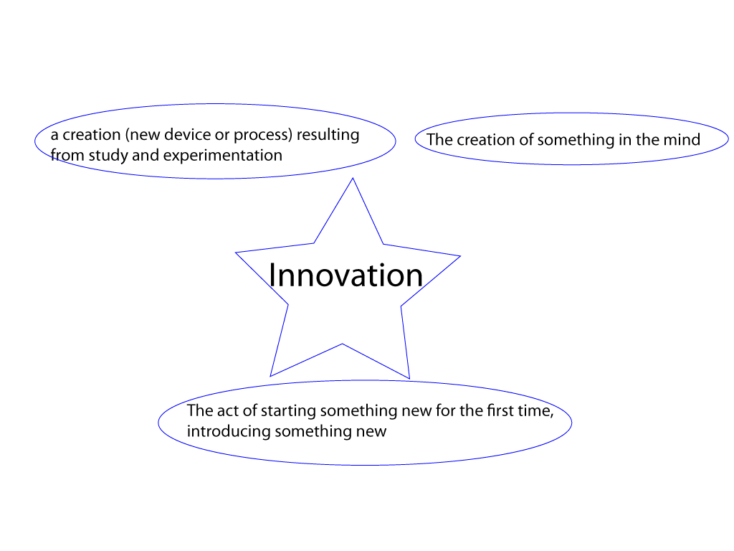
What is Innovation?

Slide 8


Slide 9
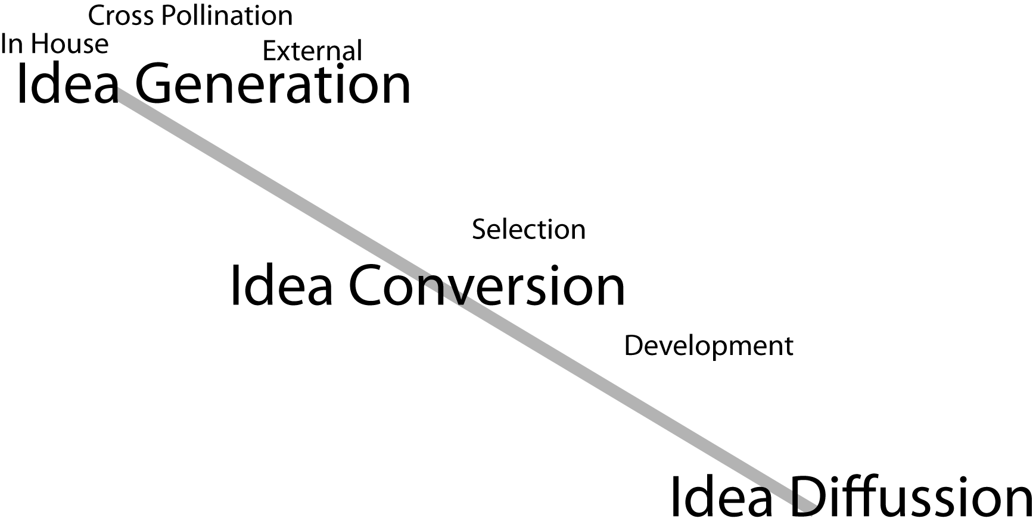
Innovation value chain

Slide 10
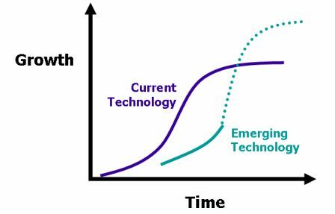
Idea Diffusion

Slide 11
Why Innovate?

Slide 12
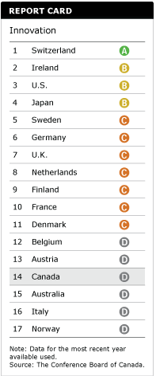
Canada’s Innovation Ranking
Conference Board of Canada 2010

Slide 13
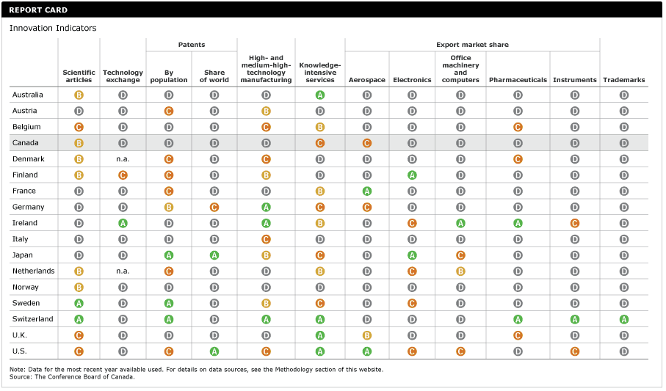
Canada’s Report Card

Slide 14
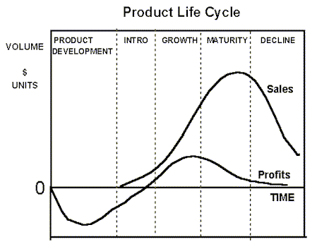
New Product Life Cycle
http://tolearn.net/marketing/plc.htm

Slide 15
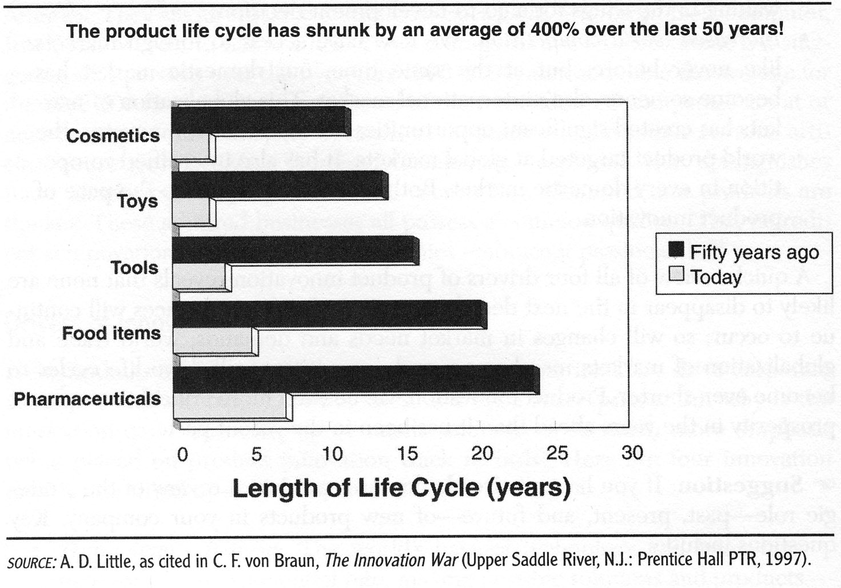
Shortening Product Life Cycles

Slide 16
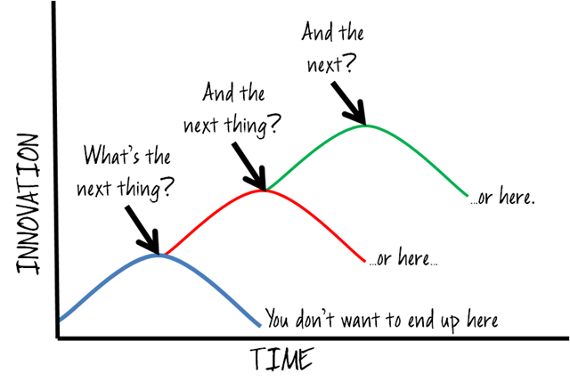
From: http://www.chrisspagnuolo.com/content/binary/WindowsLiveWriter/Ifscrumonlyhadaheart_12C27/image_4.png

Slide 17
Conditions for Economic Growth through Commercialization:
Research & Development is a necessary, but insufficient precondition
Alone, R&D does not produce growth opportunities
Requires a market or environment that produces profit opportunities
Growth opportunities require both Innovation and Entrepreneurship

Slide 18
Types of innovation

Slide 19
Axes of Innovation
Type of innovation
Disruptive vs incremental vs transformational
Product type created
Formal vs informal

Slide 20
Types of Innovation
Product Innovation – new products or improvements on products. The new Mini or the updated VX Beetle, new models of mobile phones and so on.
Process Innovation – where some part of the process is improved to bring benefit. Just in Time is a good example.
Positioning Innovation – Lucozade used to be a medicinal drink but the was repositioned as a sports drink.
Paradigm Innovation – where major shifts in thinking cause change. During the time of the expensive mainframe, Bill Gates and others aimed to provide a home computer for everyone.

Slide 21
Types of Innovation (continued)
Organizational innovation - the creation or alteration of business structures, practices, and models, and may therefore include process, marketing and business model innovation
Business Model innovation involves changing the way business is done in terms of capturing value e.g. Compaq vs. Dell, hub and spoke airlines vs. Southwest, and Hertz/Avis vs. Enterprise.
Service innovation, is similar to product innovation except that the innovation relates to services rather than to products

Slide 22

Necessity is the mother of invention or how to work with what you’ve been given

Slide 23
Incremental vs Disruptive
Incremental Innovations are the small (perhaps 1-2% a year) improvements. These are described by the Learning curve, and by terms such as "learning by doing”. One example is the development of “creep capacity “ in the chemical industry. Another is Moore’s Law. Improvements here are continuous, and these represent one of the few areas in innovation where future improvements can be predicted with any confidence. They cause relatively little disruption.
Disruptive Innovationsare the situations where a totally new technology comes along and displaces the incumbent technology. Examples are transistor replacing the vacuum tube, compact disc replacing long playing records. These changes are discontinuous, not continuous, and frequently cause significant disruption involving changes in industry leadership.
General Purpose or Transformational Technologiesis the name that has been coined to describe the really big innovations such as the waterwheel, steam power, electricity, the internal combustion engine, railways, the internet, etc. These innovations are share four characteristics:
  Wide scope for improvement and elaboration
  Wide range of uses
  Potential use in a wide range of products and processes
  Strongly complementary with other technologies

Slide 24
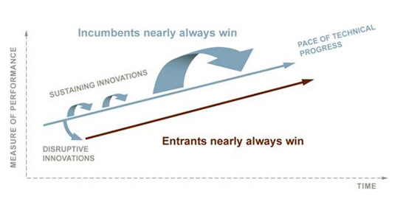
Incremental vs Disruptive
Transformational

Slide 25
Sustaining vs Disruptive Innovation
Disruptor
Disruptee
Cellular phones
Community colleges
Discount retailers
Retail medical clinics
Fixed line telephony
Four-year colleges
Full-service department stores
Traditional doctor’s offices
Clayton Christensen

Slide 26
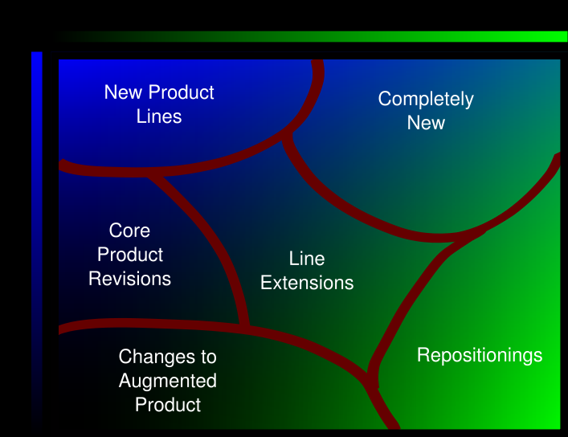
New Product Categories
Newness to Market
Newness to Company
http://en.wikipedia.org/wiki/Image:TypesOfNewProducts.svg

Slide 27

Sources of innovation

Slide 28
Sources of Innovation
Unexpected occurrences
  novocaine
Incongruities
  shipping
Process needs
  App store
Industry and market changes
  New media
Demographic changes
  healthcare
Changes in perception
  banking
New knowledge
From Drucker, P. The discipline of Innovation Harvard Business Review 2002

Slide 29
Where does innovation occur?
New Product Development
Research and Development
Prototyping
Idea Generation
Organizational Creativity
Design
Marketing/Advertising
Open Innovation/Co-Creation
Innovation Management & Leadership
Innovation Processes
Stage-Gate
Innovation Tools (mind mapping, idea management software, etc.)
Strategy & Planning
Metrics, Measurement & Analysis
Intellectual Property (Patents, Legal Protections)
Culture, People, HR
Customer/Consumer Research and Ethnography
Trends, Future Farming and Horizon Studies
Portfolio & Project Management
Scientific/Engineering
Collaboration
Training & Skill Development”
relationship management,
marketing,
communication,
user interfaces.

Slide 30
Factors Required for Innovation
Expertise
Motivation
Creative thinking skills

Slide 31
Sources of Ideas
Establish a Focal Point: Idea generation is every ones job and no ones responsibility. Ideas come up; they are recorded, transferred and translated into action. Need to assess and screen initial ideas.
Notes:
Ideas are the starting point – the trigger.
We need to identify more and better product opportunities. – How?

Slide 32
Idea Generation
Ideas can come from almost anywhere
  Inventors, customers, employees, think tanks, suppliers, accident …
  Ideas can either be “technology push” or “technology pull”
  Planned or unplanned
  Picking the right idea is key

Slide 33
Sources of Ideas
Internal
  Research & Engineering
  Sales & Marketing
  Production
External
  Customers
  Contract organization
  Competitors
  Trade Shows:
  Trade Publications:
  Patents:
  Technology Clearing Sites:
  Universities:
Notes:
Get class to expand – develop list of idea sources and techniques

Slide 34
Characteristics of an innovator

Slide 35
Innovator Skills
Associating unrelated ideas, problems or questions
Questioning – why, why not, what if, hold opposing ideas, embrace constraints
Observing – follow customers around
Experimenting – many small experiments
Networking – engage with people different than yourself

Slide 36
Innovative Companies have:
Shared values
Appreciation of the individual
Openness and playfulness
Celebrated successes
An understanding of their history
Customer centric focus
An understanding of trends
Cross functional teams
A system to reward risks
Minimal bureaucracy
A tolerance for failure
An acceptance of the not invented here idea
And…

Slide 37
Screening innovations

Slide 38
Picking the Good Innovations
Most people miss opportunity when they see it, because it comes wearing coveralls and looks like work.
Thomas Edison, 1900

Slide 39

“Ends” are what the customer values
Goal is a product with real value for the end user
From Cooper, R.G. 2001Winning at New Products

Slide 40
Success Factors for Technology Commercialization
A superior and unique product
A clearly defined product at the earliest stages of development
Thorough technical and market feasibility analysis
Well-executed marketing plan
Well-executed technology plan

Slide 41
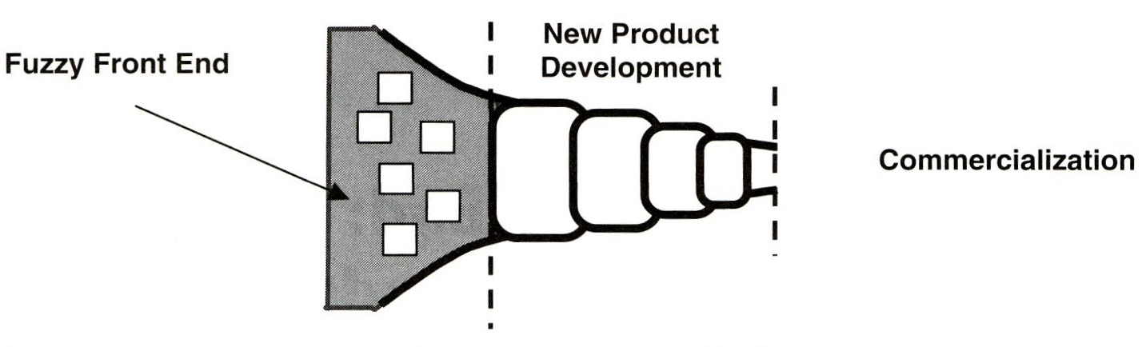
Innovation Process
From Belliveau, P. et al, The PDMA Toolbook for New Product Development, 2002
Notes:
3 parts
Not necessarily sharp divisions
Additional technology development may be required at each interface

Slide 42
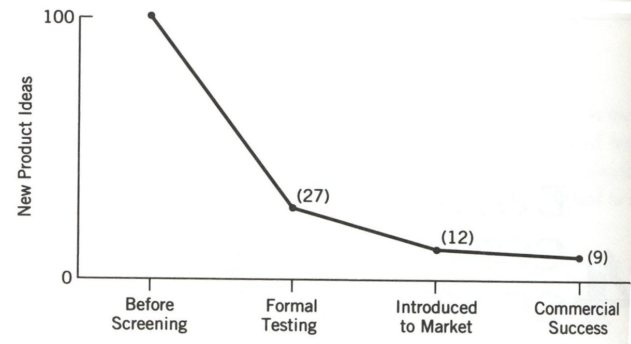
New Product Attrition Rate
From Rosenau, M.D., PDMA Handbook of New Product Development, 1996

Slide 43
Commercializing Innovation
“A random path of serendipity or a faint trail through the deep woods, fraught with danger?”
  The vast majority of products fail to make a profit.
  40% of major corporations in business in 1975 are not in business today.
Why?
Technology development must meet a market need but,
Markets evolve very rapidly

Slide 44
Product and Project Definition
This key deliverable spells out who the product is for and exactly what the product will be -benefits, features and design requirements.
  A sharp, clear and complete product definition
  If you don’t know what it is, then how can you build it?
  Build in the elements of product superiority.
  Shape the products requirements, features and specifications to deliver unique and real benefits to customers.
Notes:
Required to know what to build. Helps the project team focus on building the right product

Slide 45
Product and Product Definition includes
Project scope – defines boundaries of development effort
Definition of the target market (be precise)
Product concept – in customer language
Benefits to be delivered – customer value proposition
Positioning strategy - Price point
Product features, attributes, performance requirements and high level specifications.
Notes:
Single product or family of products
(prioritize product features as “must haves” and “would like to haves”)

Slide 46
Target Product Profile
Useful as a planning tool
Starts to define product
A defined list encompassing multiple stakeholder perspectives of the key features and attributes of the intended end-product
  Desired and must have features
Dynamic, evolving

Slide 47
Target Product Profile Contents
Strategic context
End user requirements
Commercial requirements
Technical features
Development requirements and feasibility
Desired vs minimally acceptable features

Slide 48
Justification
Answers WHY
Review of the business, financial, profitability and risk considerations.
Includes non-financial criteria and considerations
  competitive advantage,
  synergies
  leverage
  market attractiveness.
Notes:
Why invest?
Since financial is only estimates (therefore likely wrong), should include non-financial criteria
Could include alternative solutions such as partnering or outsourcing

Slide 49
User Needs-and-Wants Study:
This is the part of the market study most often omitted (with disastrous results)
  Objective: Probe the customer and flesh out the concept as they view it.
  Problem: Most of us already have a fixed idea of what the customer is looking for, therefore we usually skip this critical step.
  Remember: A superior product is one that – “Delivers unique benefits to customers”
Therefore, make certain the product under design delivers real value to the customer
Notes:
Use as a class discussion? How have they identified user needs and wants in their products. Have they ever been part of a needs and wants study?

Slide 50
User Needs and Wants Study
What is the value to the customer? What do they value and by how much?
What is a benefit? (ie. Feature they will pay more for)
What features, attributes, and performance characteristics translate into value for the customer?
Notes:
Note: the customer only will pay extra for features, attributes etc that they value.

Slide 51
Competitive Analysis:
Provides direction on achievable share of market
Need to understand the competitor’s product and its strength & weaknesses.
  Your competitor’s product is the standard by which your product will be judged.
Need to understand how the competitor plays the game, how it competes.
Need to understand competitive strategy and how the competitor’s product fits into its portfolio.
  This may give insights into how the competitor will respond when you product enters the market.

Slide 52
Competitive Analysis - Key questions
Who are the key players (major competitors)?
What are their products’ features, attributes and performance characteristics? (strengths & deficiencies)
What other strengths & weaknesses does the competitor have?
How does each competitor play the game? Types of customers, how do they get business? Pricing, quality, superior features?
How well are the competitors doing? What are their market shares? What are the secrets to their success? Figure out what is necessary to win.
(If possible) What are the competitors’ cost structures, production volumes and capacities? This will tell you how important their product is to them and how capable they are to react to your new product.

Slide 53
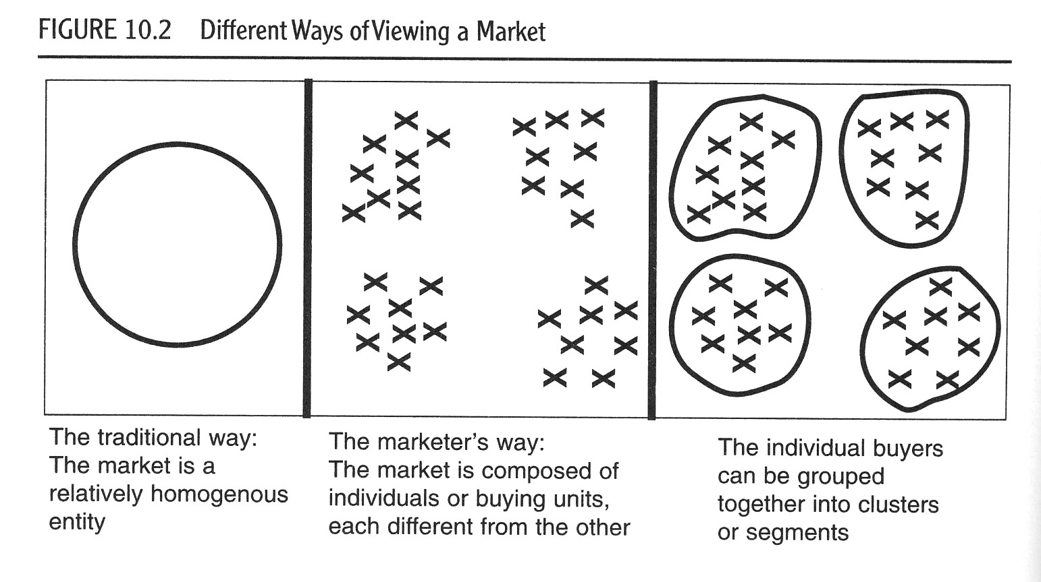
Different ways of viewing a market

Slide 54
Keys to Successful Market Research
Understand your product – target product profile/Product Definition
Understand your target audience
Start broad and narrow down

Slide 55
Market survey data
Identification of current practices
  Frequency
  Better understanding of the problem
  Current tools used to address the problem and when/why/how they are used, cost
  Shortcomings of current tools
  Reaction to target product profile
    Good, bad and ugly

Slide 56
Market analysis
Overall size
Segment size
Sources of data are important
Assumptions used
Ranges more useful than absolutes
Penetration rates
Time to peak sales and drop off later

Slide 57
Market Drivers
What are the factors that control the markets?
  Eg: Regulations
  Changing technologies
  Environmental concerns

Slide 58
Market Access
How easy is it to get access into the market
  What will others do to keep you out?
  What percentage is accessible (not currently well served)
How is the market accessed?
  Direct
  Distributors
  Retail
  Etc
How is the market regulated?

Slide 59
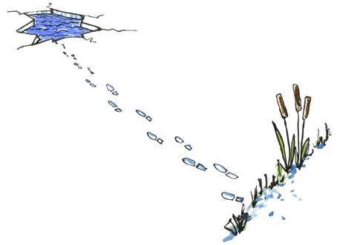
First mover advantage?
Courtesy of HikingArtist.com

Slide 60
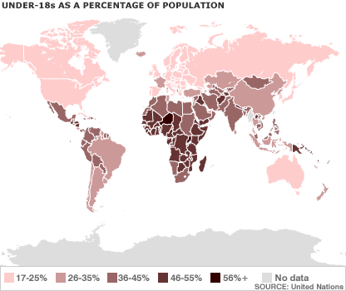
Changing Markets
9 of 10 live in the developing world
http://news.bbc.co.uk/2/shared/spl/hi/guides/456900/456998/html/default.stm

Slide 61
Detailed Technical Investigation:
What is the probable technical solution that will yield a product to meet marketplace requirements?
What is involved in arriving at the technical solution? Is invention required? Is application of fairly well known technology required?
What are the technical risks and potential roadblocks? How will they be dealt with? Can parallel alternative strategies be pursued?

Slide 62
Feasibility
What are the key steps in getting to a prototype product? How long will each step take and how much will it cost? What are the personnel requirements?
What legal, patent, regulatory and safety issues must be dealt with?
How might the product be manufactured? Are new facilities required or can it be outsourced? What would production volume be? What are the capital costs?
What is the cost per unit of manufacture for producing the product?

Slide 63
Concept Testing
Assumptions in previous analysis
  Customer understands and is able to articulate needs and wants
  You interpret the needs and wants correctly into product specs

Slide 64
Concept Testing
Customers don’t know what they want until they see it
What is it?
  Model
  Drawings
  Storyboard
  Spec sheet
  Brochure mockup
  Virtual prototype
  Etc

Slide 65
Business and Financial Analysis:
Once the market studies, user need-and-wants, competitive analysis, concept testing, feasibility and the product definition is worked out, a financial analysis must be done.
  At this point it should be possible to make reasonable estimates of many of the inputs necessary for financial analysis:

Slide 66
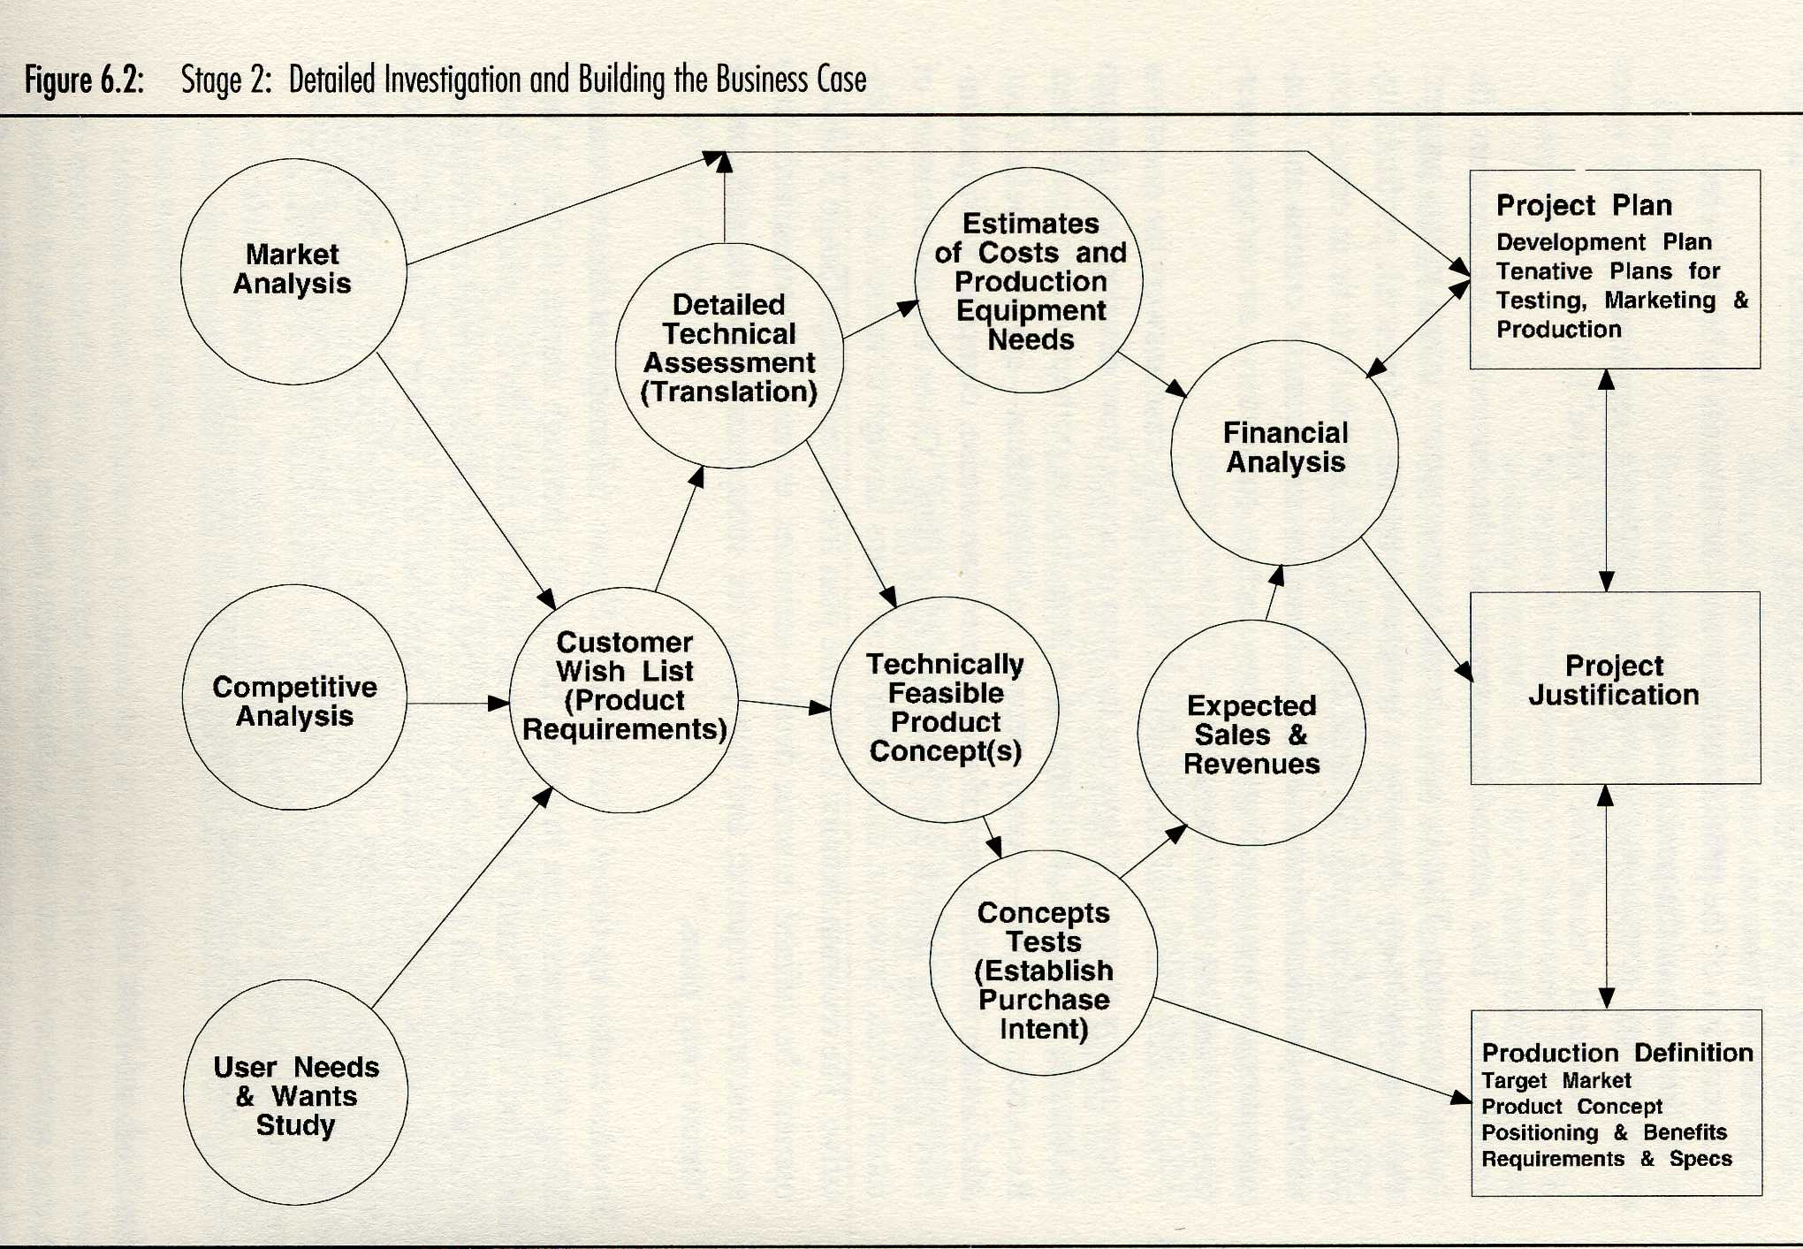
From Cooper, R.G. 2001Winning at New Products

Slide 67
Go No-Go decision points
At what point will you walk away?
What is the tipping point?

Slide 68
Challenges associated with Technology Commercialization:
Idea Generation
Market Knowledge
Competitor Knowledge
Financing
Transition through Development

Slide 69
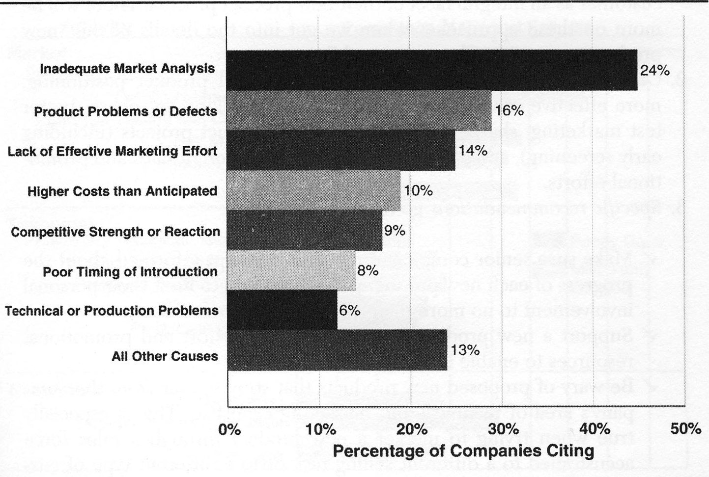
Commercialization Challenges
Cooper, R.G. 2001Winning at New Products

Slide 70
Thomas Edison failed hundreds of time in his attempts to invent a light bulb. When asked how he felt about the failures, he replied that he had not failed; he had discovered hundreds of things that did not work.

Slide 71
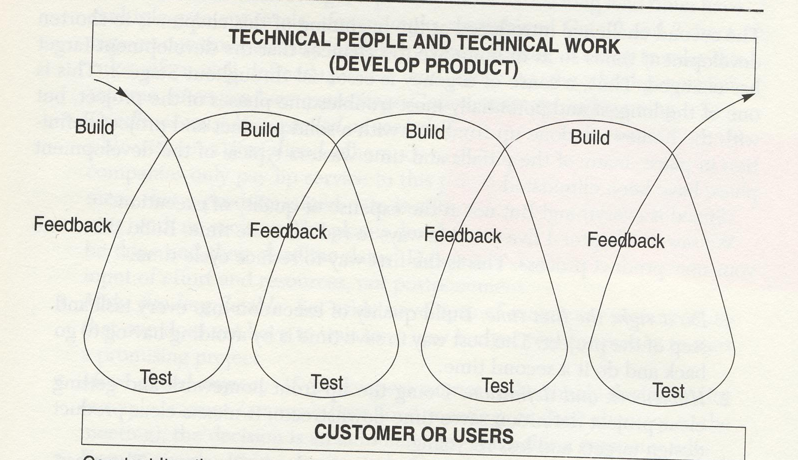

Slide 72
Summary

Slide 73
Many forms of innovation and ways to get there
Need to figure out what’s right for your situation
Selecting and developing the idea is much more work than coming up with it

